Slide 1
Serializability in DBMS

Slide 2
What is Serializability in DBMS?
When multiple transactions run concurrently, then it may give rise to inconsistency of the database.
Serializability is a concept that helps to identify which non-serial schedules are correct and will maintain the consistency of the database.
Serializable Schedules-
If a given schedule of ‘n’ transactions is found to be equivalent to some serial schedule of ‘n’ transactions, then it is called as a serializable schedule.
Properties of Serializable Schedules-
Serializable schedules behave exactly same as serial schedules. So, they are always-
Consistent
Recoverable
Casacadeless
Strict

Slide 3
Difference between Serial Schedules and Serializable Schedules-
The only difference between serial schedules and serializable schedules is that-
In serial schedules, only one transaction is allowed to execute at a time i.e. no concurrency is allowed.
Whereas in serializable schedules, multiple transactions can execute simultaneously i.e. concurrency is allowed.
Which is better- Serial Schedules or Serializable schedules?
We have mentioned that serial schedules and serializable schedules behave exactly same. The added advantage with serializable schedules is that they allow multiple transactions to execute simultaneously i.e. they allow concurrency.
Since, serializable schedules improve both resource utilization and CPU throughput, therefore serializable schedules are always better than serial schedules.

Slide 4
Types of Serializability-
Conflict Serializability
View Serializability
Two schedules having multiple transactions with conflicting operations are said to be conflict equivalent if and only if −
Both the schedules contain the same set of Transactions.
The order of conflicting pairs of operation is maintained in both the schedules.

Slide 5
The following rules are important in Conflict Serializability
1. If two transactions are both read operation, then they are not in conflict. 2. If one transaction wants to perform a read operation and other transaction wants to perform a write operation, then they are in conflict and cannot be swapped. 3. If both the transactions are for write operation, then they are in conflict, but can be allowed to take place in any order, because the transactions do not read the value updated by each other.

Slide 6
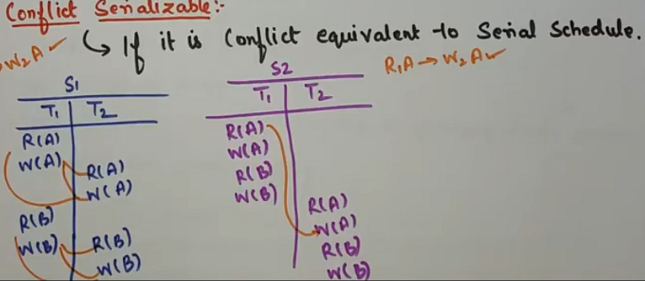

Slide 7
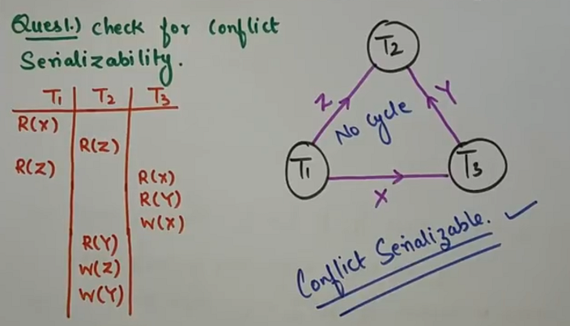
Test for Serializability
A schedule is conflit serializable if and only if precedence graph is acyclic.

Slide 8
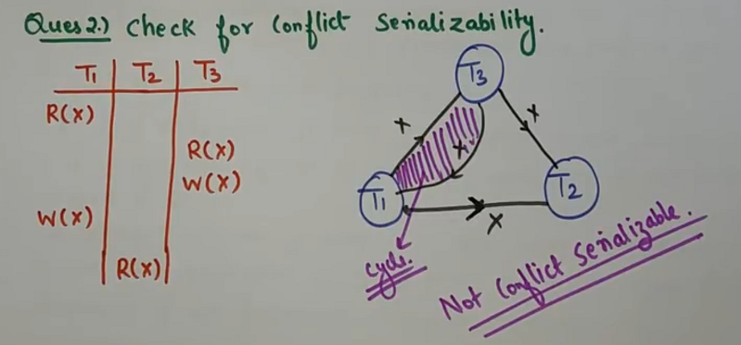

Slide 9
View Serializability-
If a given schedule is found to be view equivalent to some serial schedule, then it is called as a view serializable schedule.
What are view equivalent schedules?
Two schedules would be view equivalence if the transactions in both the schedules perform similar actions in
a similar manner.
For example −
If T reads the initial data in S1, then it also reads the initial data in S2.
If T reads the value written by J in S1, then it also reads the value written by J in S2.
If T performs the final write on the data value in S1, then it also performs the final write on the data value in S2.

Slide 10
How to check whether a given schedule is view serializable or not?
Check whether the given schedule is conflict serializable or not.
If the given schedule is conflict serializable, then it is surely view serializable. Stop and report your answer.
If the given schedule is not conflict serializable, then it may or may not be view serializable. Go and check using other methods.
Thumb rule
All conflict serializable schedules are view serializable but all view serializable schedules may or may not be conflict serializable

Slide 11
